Slide 1
Parallel and Distributed Computing
Week – 02
Different Computing Systems

Slide 2
Today We Will learn,
Cloud Computing
Grid Computing
Cluster Computing
Shared Memory Architecture
Uniform Memory Access (UMA)
Non-Uniform Memory Access (NUMA)

Slide 3
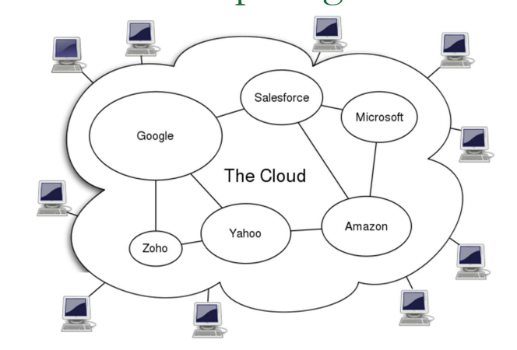
Cloud Computing
Cloud Computing is a style of computing in which dynamically scalable and often virtualized resources are provided over the Internet

Slide 4
Cloud Computing
Users need not have knowledge of, expertise in, or control over the technology infrastructure in the “cloud” that supports them
Cloud computing is the delivery of different services through the Internet. These resources include tools and applications like data storage, servers, databases, networking, and software.

Slide 5
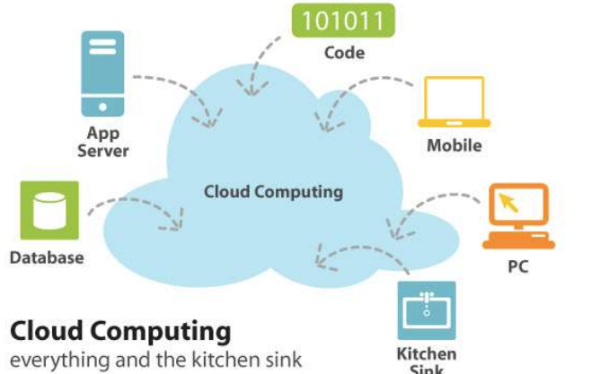
Cloud Computing
Supports to increase computing capacity or add computing capabilities at any time without investing in new infrastructure, training new personnel, or licensing new software

Slide 6
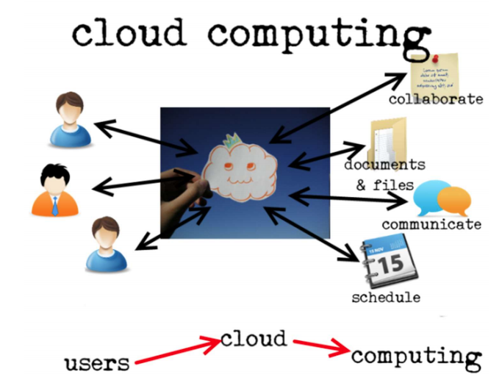
Cloud Computing

Slide 7
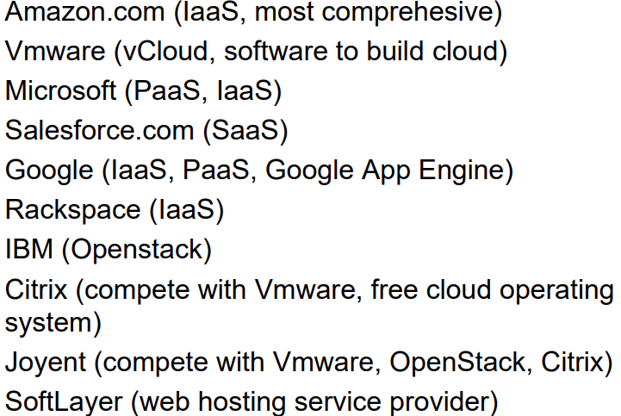
Top Players in Cloud Computing

Slide 8
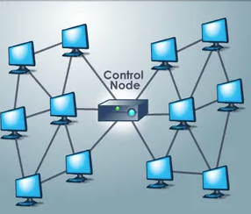
Grid Computing
Computer network in which each computer's resources are shared with every other computer in the system.
Network of computers working together to perform a task that would rather be difficult for a single machine.
All machines on that network work under the same protocol to act like a virtual supercomputer.

Slide 9
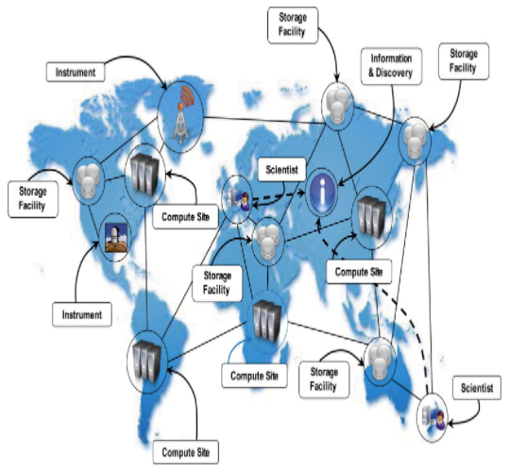
Grid Computing
Processing power, memory and data storage are all community resources that authorized users can tap into and leverage for specific tasks.
The task that they work on may include analysing huge datasets or simulating situations which require high computing power.
Computers on the network contribute resources like processing power and storage capacity to the network.

Slide 10
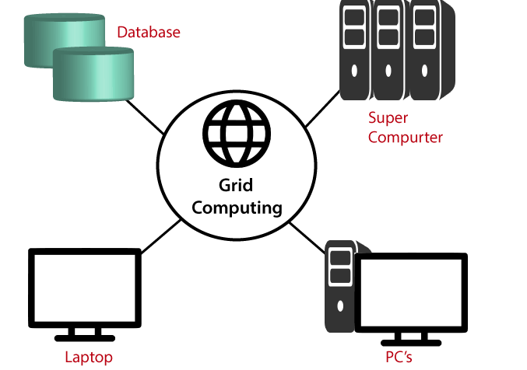
Grid Computing

Slide 11
Grid Computing
Grid Computing is a subset of distributed computing, where a virtual super computer comprises of machines on a network connected by some bus, mostly Ethernet or sometimes the Internet.
It can also be seen as a form of Parallel Computing where instead of many CPU cores on a single machine, it contains multiple cores spread across various locations.
The concept of grid computing isn’t new, but it is not yet perfected as there are no standard rules and protocols established and accepted by people.

Slide 12
Grid Computing - Working
A Grid computing network mainly consists of these three types of machines
Control Node:
A computer, usually a server or a group of servers which administrates the whole network and keeps the account of the resources in the network pool
Provider:
The computer which contributes it’s resources in the network resource pool.
User: The computer that uses the resources on the network.

Slide 13
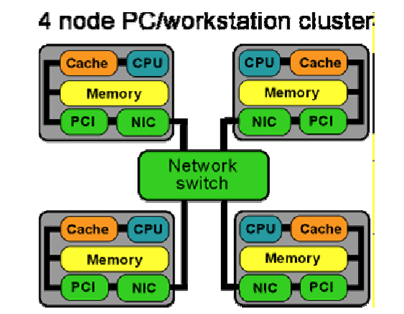
Networked Cluster of Workstations (PCs)
Computer network that connects several computer workstations with special software forming a cluster, to act as a distributed supercomputer on a building-wide scale
Example: The Berkeley Network of Workstations (NOW) project seeks to harness the power of clustered machines connected via high-speed switched networks

Slide 14
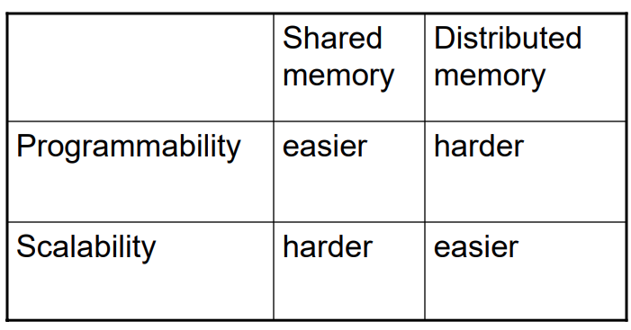
Architectural Design Tradeoffs

Slide 15
Cluster Computing
Cluster Computing or High-Performance computing frameworks is a form of computing in which group of computers (often called nodes) that are connected through a LAN (local area network) so that, they behave like a single machine.
A computer cluster help to solve complex operations more efficiently with much faster processing speed, better data integrity than a single computer and they only used for mission-critical application (automatic vehicle locator (AVL) app might be mission-critical for an ambulance company )
The connected computers execute operations all together thus creating the idea of a single system.
The clusters are generally connected through fast local area networks (LANs)

Slide 16
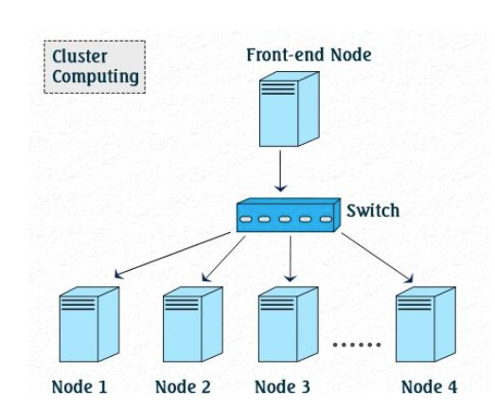
Cluster Computing

Slide 17
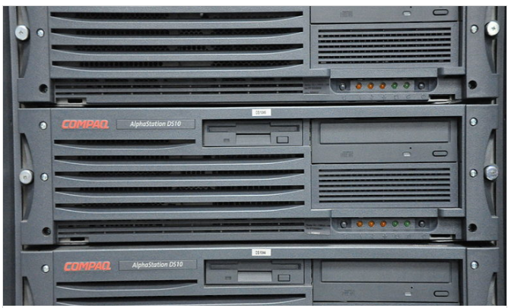
Beowulf Cluster System
A beowulf cluster is formed using normal computers that are identical.
These are arranged into a small local area network (LAN).
beowulf clusters form a parallel processing unit using common personal computers.
The primary use of beowulf clusters in modern times is for scientific computing.

Slide 18
Beowulf Cluster System
Moderate size: Normally 16 to 32 PC’s 
Promise of good price/performance ratio 
Use of commodity-of-the-self (COTS) components (PCs, Linux, MPI) 
Initiated at NASA (Center of Excellence in Space Data and Information Sciences) in 1994 using 16 DX4 processors 
http://www.beowulf.or

Slide 19
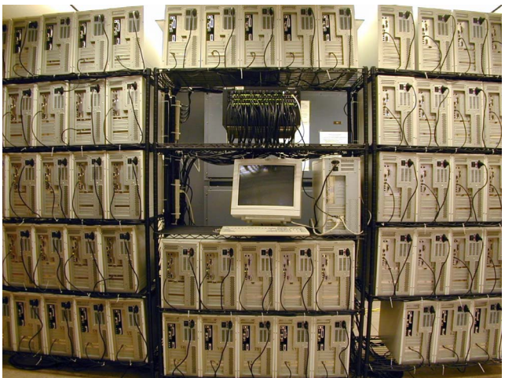
NASA 128-Processor Beowulf Cluster

Slide 20
Shared Memory Architecture
Parallel computers can also be classified according to memory access 
Shared memory computers 
Message-passing (distributed memory) computers 
Multi-processor computers 
Multi-computers 
Clusters 
Grids

Slide 21
Shared Memory and Message Passing
All processors have access to all memory as a global address space 
Multiple processors can operate independently, but share the same memory resources 
Changes in a memory location effected by one processor are visible to all other processors 
Two classes of shared memory machines: UMA and NUMA, (and COMA)

Slide 22
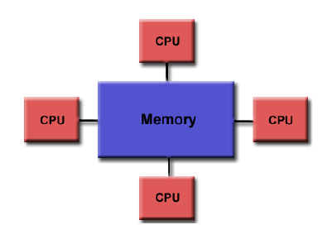
Shared Memory Architecture

Slide 23
Uniform Memory Access (UMA)
Most commonly represented today by Symmetric Multiprocessor (SMP) machines 
Identical processors 
Equal access and access time to memory 
Sometimes called CC-UMA – Cache Coherent UMA  Cache Coherence:
If one processor updates a location in shared memory, all the other processors know about the update. Cache coherence is accomplished at the hardware level

Slide 24
Symmetric Multiprocessor - Multiprocessing(MP)
Involves computer hardware and software architecture where there are multiple(two or more) processing units executing programs for the single operating(computer) system.
These systems have multiple processors working in parallel that share the computer clock, memory, bus, peripheral devices
Two Possible types
Symmetric multiprocessing
Asymmetric multiprocessing

Slide 25
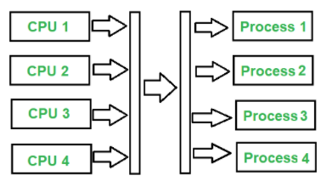
Symmetric Multiprocessor - Multiprocessing(MP)
It involves a multiprocessor computer hardware and software architecture where two or more identical processors are connected to a single, shared main memory, have full access to all input and output devices
Type of multiprocessing where each processor is self scheduling.
For example, SMP applies multiple processors to that one problem, known as parallel programming.

Slide 26
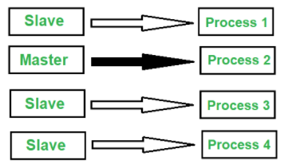
Asymmetric Multiprocessor - Multiprocessing(MP)
Asymmetric Multiprocessing system is a multiprocessor computer system where not all of the multiple interconnected central processing units (CPUs) are treated equally.
In asymmetric multiprocessing, only a master processor runs the tasks of the operating system.
For example, AMP can be used in assigning specific tasks to CPU based on priority and importance of task completion.

Slide 27
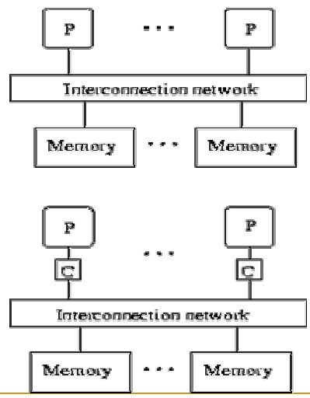
UMA –with and without caches

Slide 28
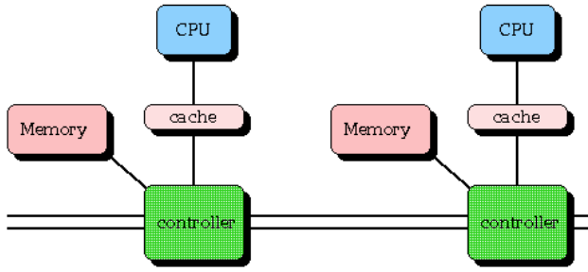
Non-uniform Memory Access (NUMA)
Often made by physically linked two or more SMPs 
One SMP can directly access memory of another SMP 
Not all processors have equal access time to all memories 
Memory access across link is slower 
If cache coherence is maintained, they may also be called CC-NUMA
As multiple processors operate in parallel, and independently multiple caches may possess different copies of the same memory block, this creates cache coherence problem.
Cache coherence schemes help to avoid this problem by maintaining a uniform state for each cached block of data

Slide 29
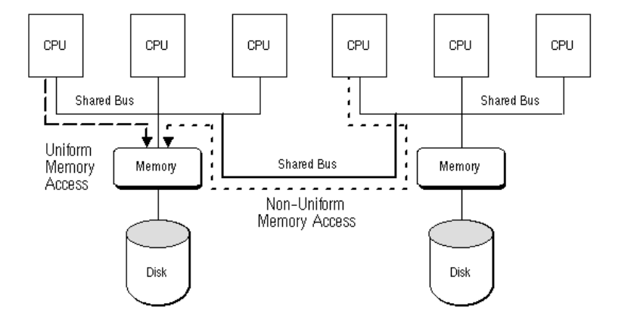
Hybrid Machine (UMA & NUMA)
As multiple processors operate in parallel, and independently multiple caches may possess different copies of the same memory block, this creates cache coherence problem.
Cache coherence schemes help to avoid this problem by maintaining a uniform state for each cached block of data

Slide 30
Advantages & Disadvantages of Shared Memory
Advantages
Global address space provides a user-friendly programming environment to memory access 
Data sharing between tasks is both fast and uniform due to proximity of memory to CPU
Disadvantages
Lack of scalability between memory and CPUs: Adding processors can geometrically increase traffic on the shared memory-CPU path and for cache coherence management 
Programmer’s responsibility for synchronization constructs (correct access to memory) 
Expensive to design shared memory computers with increasing numbers of processors
As multiple processors operate in parallel, and independently multiple caches may possess different copies of the same memory block, this creates cache coherence problem.
Cache coherence schemes help to avoid this problem by maintaining a uniform state for each cached block of data

Slide 31
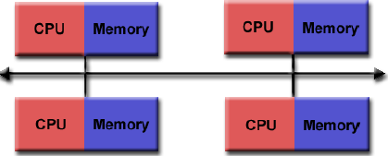
Parallel Computing - Distributed Memory
Distributed memory systems require a communication network to connect inter-processor memory.

Slide 32
Parallel Computing - Distributed Memory
Advantages
Memory is scalable with the number of processors 
Increase the number of processors, the size of memory increases proportionally 
Each processor can rapidly access its own memory without interference and without the overhead incurred with trying to maintain cache coherence 
Cost effectiveness: can use commodity, off-theshelf processors and networking

Slide 33
Parallel Computing - Distributed Memory
Disadvantages
Difficult to program: Programmer has to handle data communication between processors  Nonuniform memory access (NUMA) times 
It may be difficult to map existing data structures, based on global memory, to distributed memory organization

Slide 34
Assignment - Only Hand-Written Accepted
Compare Parallel & Distributed Computing
Enlist the similarities/dissimilarities between Parallel & Grid Computing
Grid Computing & Distributed Computing
Distributed Computing & Cloud Computing
Cloud Computing & Grid Computing

